Slide 1
COMMERCE –III ( MF)
Dr. Sumita Shankar

Slide 2
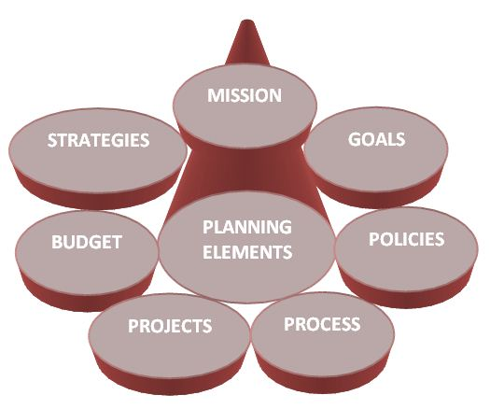
COMPONENTS OF PLANNING

Slide 3
COMPONENTS OF PLANNING
Standing plans
Single use plans
Standing plans are plans designed to be used again and again. Examples include policies, procedures, and regulations.
These plans are made for handling non-recurring problems. Single-use plans are also referred to as ‘specific plans’ since these are meant to solve a particular problem. These plans are formulated to handle non-repetitive and unique problem. These plans cannot be used again and again;

Slide 4
STANDING PLANS 1. MISSION 2. OBJECTIVE 3. POLICIES 4. PROCEDURES 5. RULES 6. STRATEGIES 7. FORECASTING

Slide 5
STANDING PLANS 1. MISSION

Slide 6
STANDING PLANS 2. OBJECTIVES / GOALS

Slide 7
STANDING PLANS 3. POLICIES

Slide 8
STANDING PLANS 4. PROCEDURES

Slide 9
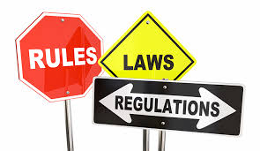
STANDING PLANS 5. RULES

Slide 10
STANDING PLANS 6. STRATEGIES

Slide 11
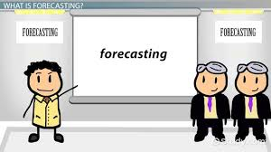
STANDING PLANS 7. FORECASTING

Slide 12
SINGLE USE PLANS 1. PROGRAMMES 2. PROJECTS 3. BUDGETS 4. SCHEDULES 5. STANDARDS

Slide 13
SINGLE USE PLANS 1. PROGRAMMES

Slide 14
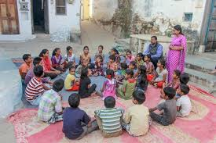
SINGLE USE PLANS 2. PROJECTS

Slide 15
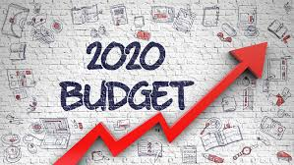
SINGLE USE PLANS 3. BUDGETS

Slide 16
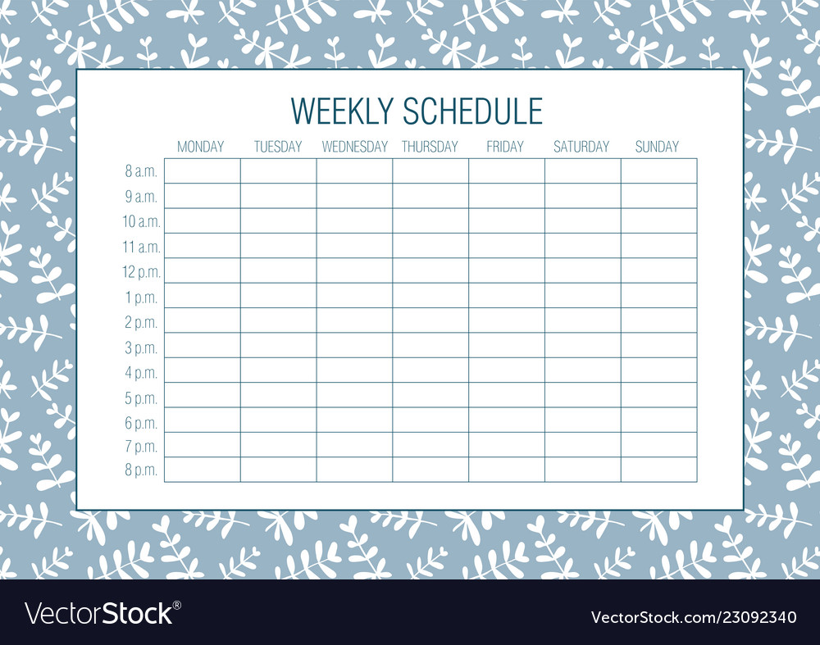
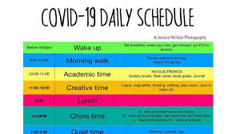
SINGLE USE PLANS 4. SCHEDULES

Slide 17
SINGLE USE PLANS 5. STANDARDS

